Slide 1
WebGL - Sample Application
Dr. Lathsamy Chidtavong
Mobile: +8562077712077
Email: l.chidtavong@nuol.edu.la

Slide 2
A Simple WebGL Application
WebGL is just a drawing library—another kind of canvas, akin to the 2D Canvas supported in all HTML5 browsers. In fact, WebGL actually uses the HTML5 Canvas element to get 3D graphics into the browser page.
In order to render WebGL into a page, an application must, at a minimum, perform the following steps:

Slide 3
A Simple WebGL Example
Create a Canvas element.
Obtain a drawing context for the canvas.
Initialize the viewport.
Create one or more buffers containing the data to be rendered (typically vertices).
Create one or more matrices to define the transformation from vertex buffers to screen space.
Create one or more shaders to implement the drawing algorithm.
Initialize the shaders with parameters.
Draw.

Slide 4
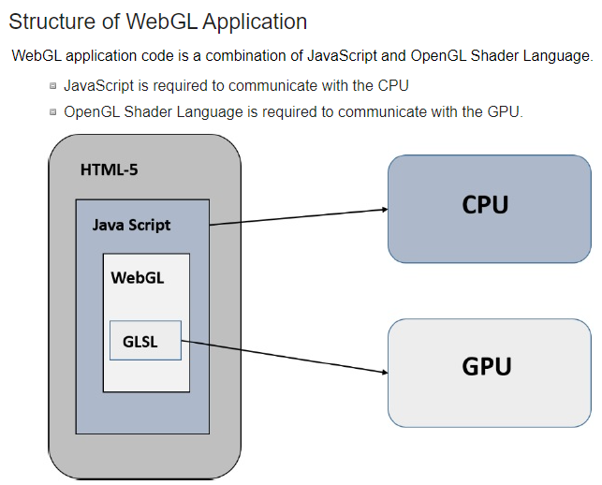

Slide 5
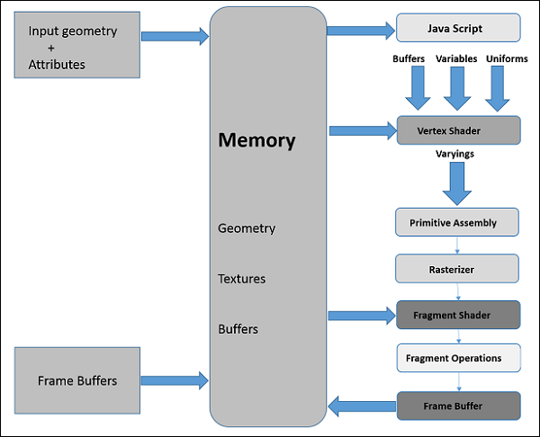
WebGL - Graphics Pipeline
To render 3D graphics, we have to follow a sequence of steps. These steps are known as graphics pipeline or rendering pipeline.
The following diagram depicts WebGL graphics pipeline.

Slide 6
ສ່ວນ​ຂອງ JavaScript
While developing WebGL applications, we write Shader language code to communicate with the GPU. JavaScript is used to write the control code of the program, which includes the following actions
Initialize WebGL − JavaScript is used to initialize the WebGL context.
Create arrays − We create JavaScript arrays to hold the data of the geometry.
Buffer objects − We create buffer objects (vertex and index) by passing the arrays as parameters.
Shaders − We create, compile, and link the shaders using JavaScript.
Attributes − We can create attributes, enable them, and associate them with buffer objects using JavaScript.
Uniforms − We can also associate the uniforms using JavaScript.
Transformation matrix − Using JavaScript, we can create transformation matrix.

Slide 7
Vertex Shader
When we start the rendering process by invoking the methods drawElements() and drawArray(), the vertex shader is executed for each vertex provided in the vertex buffer object.
It calculates the position of each vertex of a primitive polygon and stores it in the varying gl_position. It also calculates the other attributes such as color, texture coordinates, and vertices that are normally associated with a vertex.

Slide 8
Primitive Assembly
After calculating the position and other details of each vertex, the next phase is the primitive assembly stage. Here the triangles are assembled and passed to the rasterizer.

Slide 9
Rasterization
In the rasterization step, the pixels in the final image of the primitive are determined. It has two steps:
Culling − Initially the orientation (is it front or back facing?) of the polygon is determined. All those triangles with improper orientation that are not visible in view area are discarded. This process is called culling.
Clipping − If a triangle is partly outside the view area, then the part outside the view area is removed. This process is known as clipping.

Slide 10
Fragment Shader
The fragment shader gets
data from the vertex shader in varying variables,
primitives from the rasterization stage, and then
calculates the color values for each pixel between the vertices.
The fragment shader stores the color values of every pixel in each fragment.

Slide 11
Fragment Operations
Fragment operations are carried out after determining the color of each pixel in the primitive. These fragment operations may include the following −
Depth
Color buffer blend
Dithering
Once all the fragments are processed, a 2D image is formed and displayed on the screen. The frame buffer is the final destination of the rendering pipeline.

Slide 12
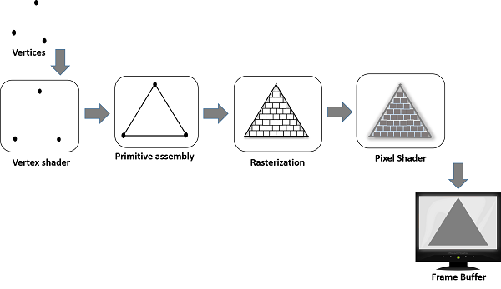
Fragment Operations

Slide 13
Frame Buffer
Frame buffer is a portion of graphics memory that hold the scene data. This buffer contains details such as width and height of the surface (in pixels), color of each pixel, and depth and stencil buffers.

Slide 14

A Simple WebGL Example
https://www.tutorialspoint.com/webgl/webgl_sample_application.htm

Slide 15
A Simple WebGL Example
Step 1 − Prepare the canvas and get WebGL rendering context
We get the current HTML canvas object and obtain its WebGL rendering context.
Step 2 − Deffine the geometry and store it in buffer objects
We define the attributes of the geometry such as vertices, indices, color, etc., and store them in the JavaScript arrays. Then, we create one or more buffer objects and pass the arrays containing the data to the respective buffer object. In the example, we store the vertices of the triangle in a JavaScript array and pass this array to a vertex buffer object.

Slide 16
A Simple WebGL Example
Step 3 − Create and compile Shader programs
We write vertex shader and fragment shader programs, compile them, and create a combined program by linking these two programs.
Step 4 − Associate the shader programs with buffer objects
We associate the buffer objects and the combined shader program.
Step 5 − Drawing the required object (triangle)
This step includes operations such as clearing the color, clearing the buffer bit, enabling the depth test, setting the view port, etc. Finally, you need to draw the required primitives using one off the methods − drawArrays() or drawElementts().

Slide 17
WebGL - Context
To write a WebGL application, first step is to get the WebGL rendering context object. This object interacts with the WebGL drawing buffer and can call all the WebGL methods.
The following operations are performed to obtain the WebGL context:
Create an HTML-5 canvas
Get the canvas ID
Obtain WebGL

Slide 18
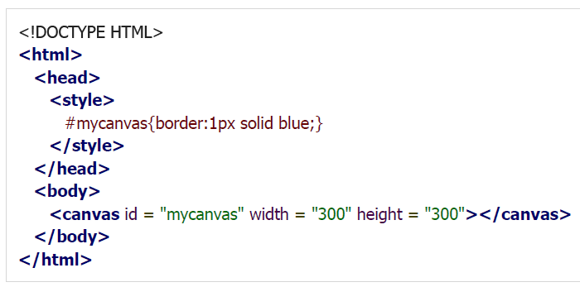

WebGL Context
Example: the following example shows how to create a canvas element with the dimensions 500 × 500. We have created a border to the canvas using CSS for visibility.

Slide 19
WebGL Context
Get IDGet the Canvas ID
After creating the canvas, you have to get the WebGL context. The first thing to do to obtain a WebGL drawing context is to get the id of the current canvas element.
Canvas ID is acquired by calling the DOM (Document Object Model) method getElementById()..This method accepts a string value as parameter, so we pass the name of the current canvas to it.
For example, if the canvas name is my_canvasmy_canvas, below−, then canvas ID is obtained as shown below−
var canvas = document.getElementById('my_Canvas');

Slide 20

WebGL Context
Get the WebGL Drawing Context
To get the WebGLRenderingContext object (or WebGL Drawing context object or simply WebGL context), call the getContext() method of the current HTMLCanvasElement.
Pass the strings webgl or experimental-webgl as the contentType. The contextAttributes parameter is optional.

Slide 21
WebGL Context
WebGLContextAttributes
The parameter WebGLContextAttributes is not mandatory. This parameter provides various options that accept Boolean values as listed below
Alpha: If its value is true, it provides an alpha buffer to the canvas. By default, its value is true.
Depth: If its value is true, you will get a drawing buffer which contains a depth buffer of at least 16 bits. By default, its value is true.
Stencil: If its value is true, you will get a drawing buffer which contains a stencil buffer of at least 8 bits. By default, its value is false.

Slide 22
WebGL Context
WebGLContextAttributes
Antialias: If its value is true, you will get a drawing buffer which performs anti-aliasing. By default, its value is true.
PremultipliedAlpha: If its value is true, you will get a drawing buffer which contains colors with pre-multiplied alpha. By default, its value is true.
PreserveDrawingBuffer: If its value is true, the buffers will not be cleared and will preserve their values until cleared or overwritten by the author. By default, its value is false.

Slide 23

WebGL Context
WebGLContextAttributes
The following code snippet shows how to create a WebGL context with a stencil buffer, which will not perform anti-aliasing.
At the time of creating the WebGLRenderingContext, a drawing buffer is created. The Context object manages OpenGL state and renders to the drawing buffer.

Slide 24
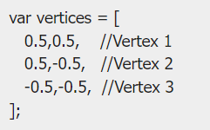
WebGL - Geometry
Defining the Required Geometry
A 2D or 3D model drawn using vertices is called a mesh. Each facet in a mesh is called a polygon and a polygon is made of 3 or more vertices.
To draw models in the WebGL rendering context, you have to define the vertices and indices using JavaScript arrays.
For example, if we want to create a triangle which lies on the coordinates {(5,5), (-5,5), (-5,-5)} as shown in the diagram, then you can create an array for the vertices as:

Slide 25
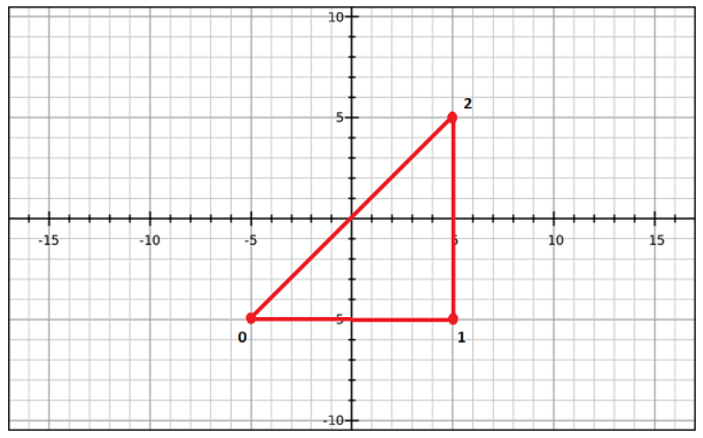
WebGL - Geometry

Slide 26


WebGL - Geometry
Defining the Required Geometry
Similarly, you can create an array for the indices. Indices for the above triangle indices will be [0, 1, 2] and can be defined as:
For a better understanding of indices, consider more complex models like square. We can represent a square as a set of two triangles. If (0,3,1) and (3,1,2) are the two triangles using which we intend to draw a square, then the indices will be defined as:

Slide 27
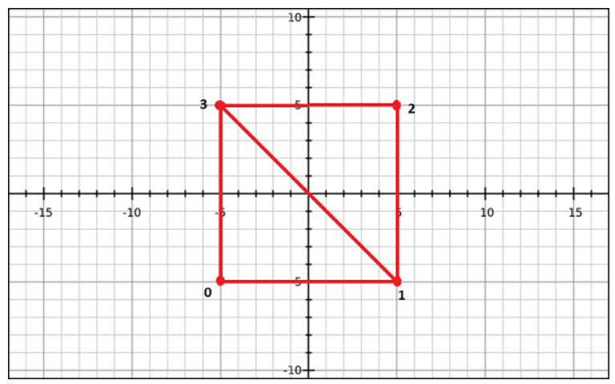
WebGL - Geometry

Slide 28
WebGL - Geometry
Note
For drawing primitives, WebGL provides the following two methods −
drawArrays() − While using this method, we pass the vertices of the primitive using JavaScript arrays.
drawElements() − While using this method, we pass both vertices and indices of the primitive using JavaScript array.

Slide 29
Two Shaders in WebGL
WebGL offers the Programmable Pipeline, which is powerful but also difficult to understand and use. The Programmable Pipeline means as the programmer you take responsibility for getting the vertices and so forth rendered to the screen.
Shaders are a part of this pipeline, and there are two types of them:
Vertex shaders
Fragment shaders
Both run entirely on graphics card's GPU. This means that we want to offload all that we can to them, leaving our CPU to do other work.

Slide 30
Vertex Shaders
Take a standard primitive shape, like a sphere, Line, Circle... It's made up of vertices, right? A vertex shader is given every single one of these vertices in turn and can mess around with them.
It's up to the vertex shader what it actually does with each one, but it has one responsibility: it must at some point set something called gl_Position, a 4D float vector, which is the final position of the vertex on screen.

Slide 31
Fragment Shaders
So we have our object with its vertices, and we've projected them to the 2D screen, but what about the colours we use? What about texturing and lighting? That's exactly what the fragment shader is there for.
The fragment shader also only has one must-do job: it must set or discard the gl_FragColor variable, another 4D float vector, which the final colour of our fragment.
What is a fragment? Think of three vertices which make a triangle. Each pixel within that triangle needs to be drawn out. A fragment is the data provided by those three vertices for the purpose of drawing each pixel in that triangle.
Because of this the fragments receive interpolated values from their constituent vertices. If one vertex is coloured red, and its neighbour is blue we would see the colour values interpolate from red, through purple, to blue.

Slide 32
Shader Variables
There are three declarations you can make:
Uniforms are sent to both vertex shaders and fragment shaders and contain values that stay the same across the entire frame being rendered. A good example of this might be a light's position.
Attributes are values that are applied to individual vertices. Attributes are only available to the vertex shader.
Varyings are variables declared in the vertex shader that we want to share with the fragment shader. To do this we make sure we declare a varying variable of the same type and name in both the vertex shader and the fragment shader.

Slide 33
Reference
https://www.tutorialspoint.com/webgl/webgl_sample_application.htm
https://webglfundamentals.org/webgl/lessons/webgl-how-it-works.html
https://webgl-shaders.com/

